Slide 1
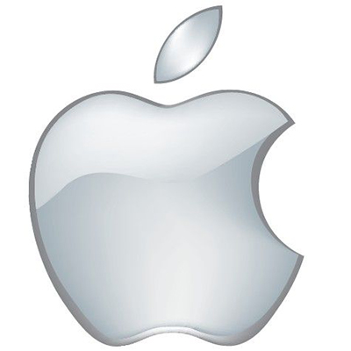

The Apple of Our Eye: A Look at the History of Apple Inc.

Slide 2
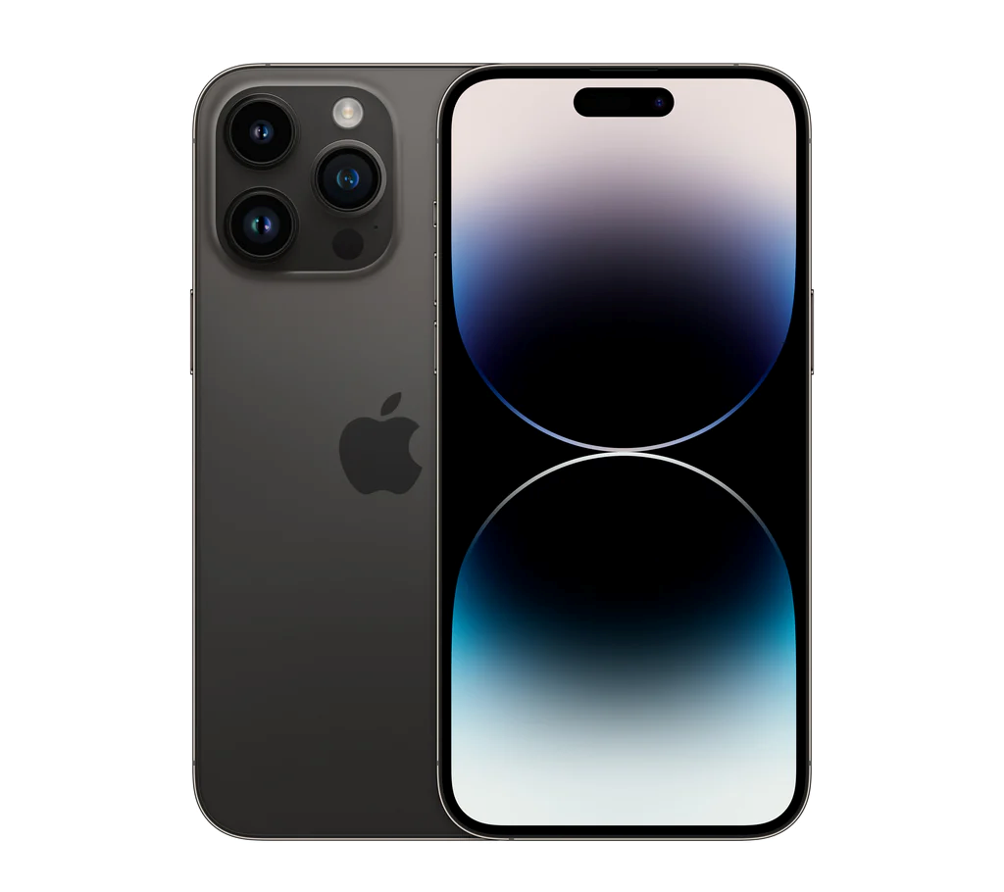
Introduction
Apple’s Reputation
Apple Products are Widespread
Apple's history, products, and impact

Slide 3

History of Apple Inc.
The founding of Apple
Early success with the Apple II computer
Introduction of the Macintosh computer and the return of Steve Jobs to Apple

Slide 4
Products of Apple Inc.
Apple's range of products including the iPhone, iPad, and Apple Watch
The features and innovations of Apple's products
Apple's approach to design and user experience

Slide 5
Impact of Apple Inc.
Apple's influence on the technology industry
Apple's contribution to the smartphone and tablet market
Apple's role in shaping modern culture and society

Slide 6

"Creativity is just connecting things. When you ask creative people how they did something, they feel a little guilty because they didn't really do it, they just saw something. It seemed obvious to them after a while. That's because they were able to connect experiences they've had and synthesize new things." - Steve Jobs

Slide 7
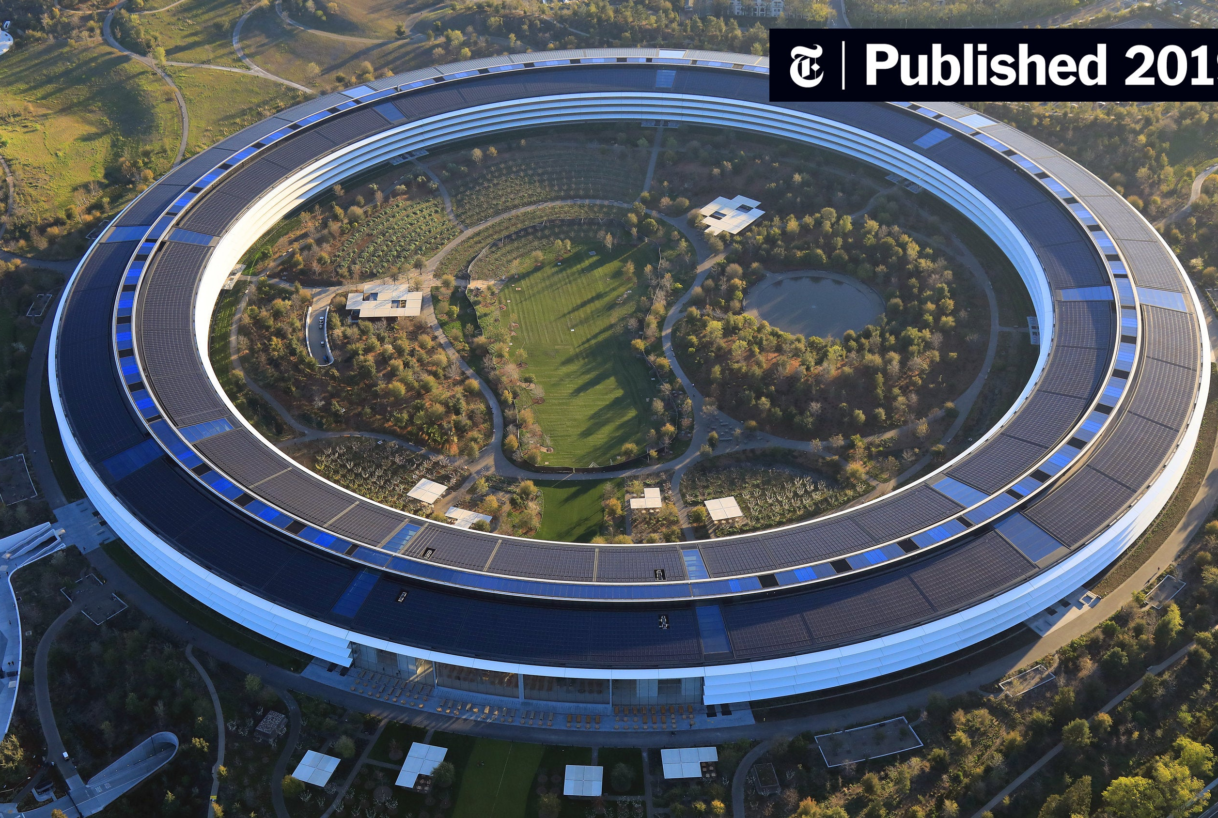
Apple’s Headquarters

Slide 8

Conclusion
Recap the history, products, and impact of Apple Inc.
Steve Jobs about innovation and creativity

Slide 9
Thank you!

